Slide 1



Integration of SasView into FitBenchmarking
Atijit Anuchitanukul (Atom)
Electronic and Electrical Engineering
University College London
Notes:
Add ISIS logo
Find better logo for SasView
Slide numbers

Slide 2
FitBenchmarking
FitBenchmarking is a tool which benchmarks the performance of each fit minimizer
Results are displayed in a form of two HTML tables
Accuracy Table
Runtime Table
Notes:
Less text
Add table

Slide 3
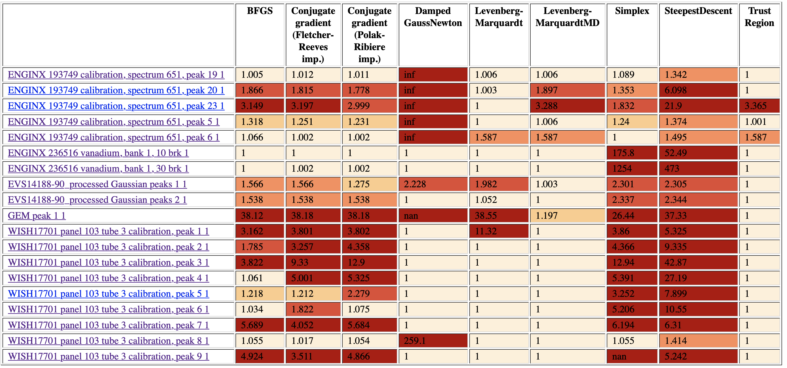
Example Accuracy Table
Notes:
Less text
Add table

Slide 4



Why is this integration beneficial?
Extend the list of minimizers to be benchmarked
Allow users to explore the best minimizer for their problem sets
Notes:
Have mantid and scipy at the start
remove etc.
remove text

Slide 5
Overview
The Structure of FitBenchmarking
Phase 1: Improvements to the FitBenchmarking tool
Phase 2: Integration of SasView
Notes:
Remove Phase 1

Slide 6
Structure of FitBenchmarking
User Configuration
Parsing a Problem Set
Select Minimizers from that Software
Select Fitting Software
Select a Problem Set
Problem Object
One Problem Set
Read
Function, f(x)
Problem Definition
Script for Parsing
Data X
Data Points
Data Y
Extract
…
Notes:
Add highlights

Slide 7
Structure of FitBenchmarking
Function Definition Object
3. Prepare the Function and the Data
Function, f(x)
Initial Parameter Values
Problem Object
Function, f(x)
Function Definition Module
…
Initial Parameter Values
Formatted Data Object
Data X
Data X
Data Preparation Module
Data Y
Data Y
…
Data E (Errors)
Notes:
Add highlights

Slide 8
Structure of FitBenchmarking
4. Fitting the function against the data points
Function Definition Object
Result Object
Fitted Data Y
Formatted Data Object
Fitting Module
Optimal Function Parameters
Accuracy (Chi-Square)
Minimizers List
Run Time
Levenberg-Marquardt
…
Simplex
Trust Region

Slide 9
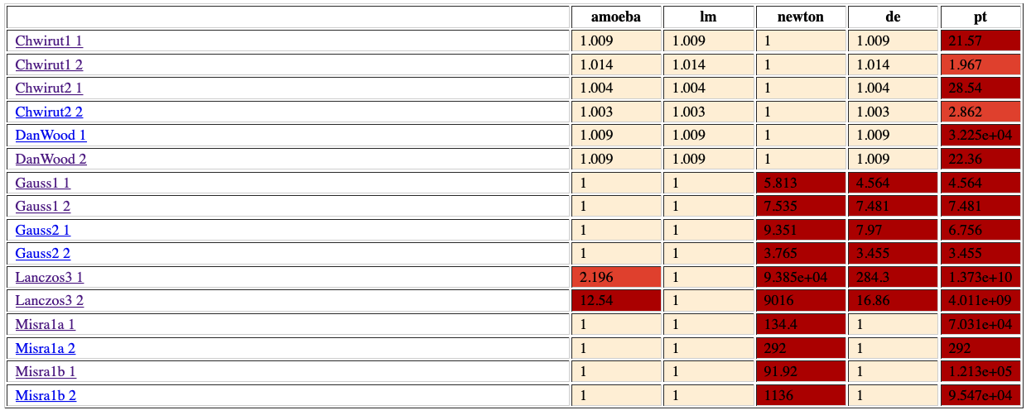
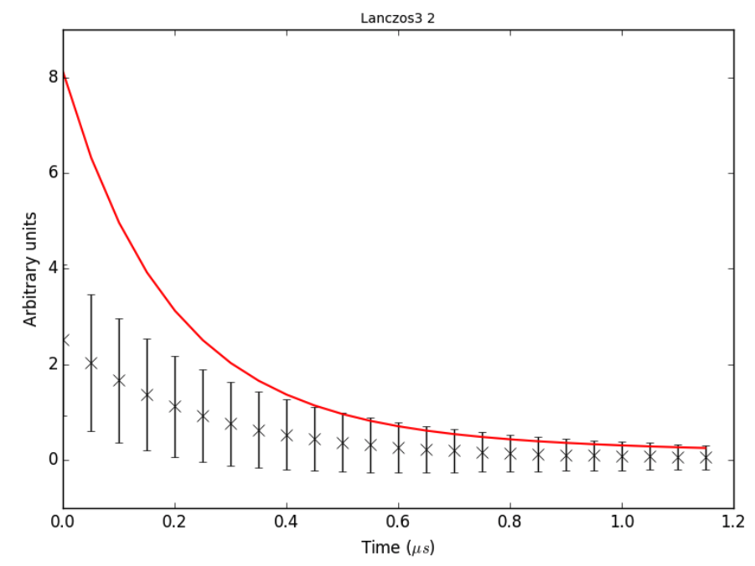
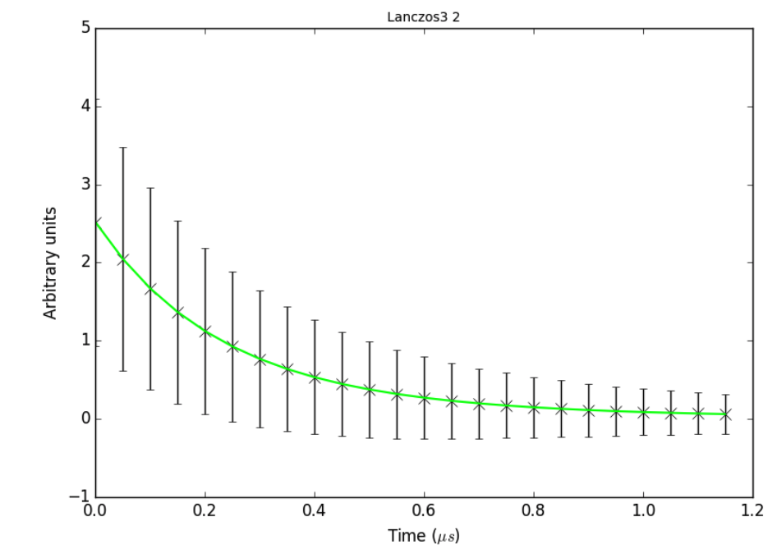
Structure of FitBenchmarking
5. Producing Figures and Tables from the Results
Result Object
Fitted Data Y
Graph Plotting Module
Table Creating Module
Optimal Function Parameters
Accuracy (Chi-Square)
Run Time
…
Notes:
*Producing
Explaination of the colours

Slide 10
Summer Project
Objectives
Bug Fixes
General Fixes
SasView integration
Notes:
Bug fixes
General fixes

Slide 11
Phase 1: Improvements to FitBenchmarking
A total of 11 Issues were solved
Maintenance and enhancement issues for FitBenchmarking
Two of these issues will be explained in the following slides
Notes:
-Summer project
Shorten first point
Improvements

Slide 12
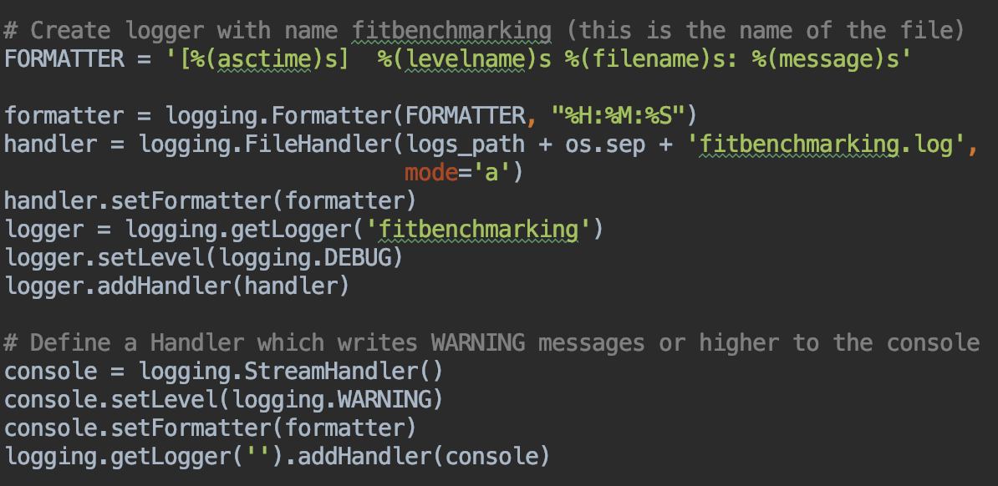
Example 1: Improvement on Python Logging in FitBenchmarking
Log messages are also improved to be more understandable
Improvements:
The location of where the message is sent from is included
Log messages were originally hard to comprehend
They were also sent from different places -> Hard to track
Warning and Error Messages are also displayed on console
Notes:
Simplify the second point
Show examples

Slide 13
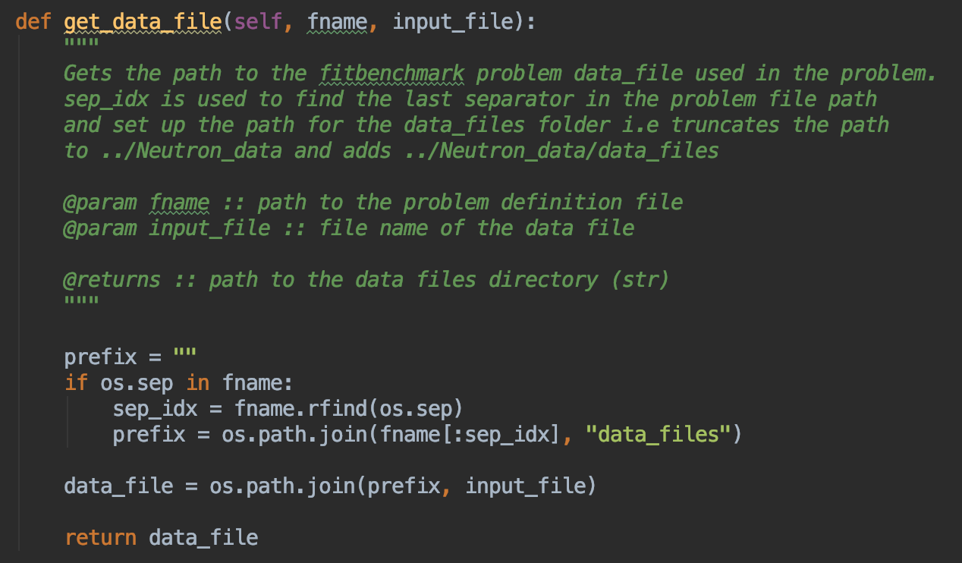
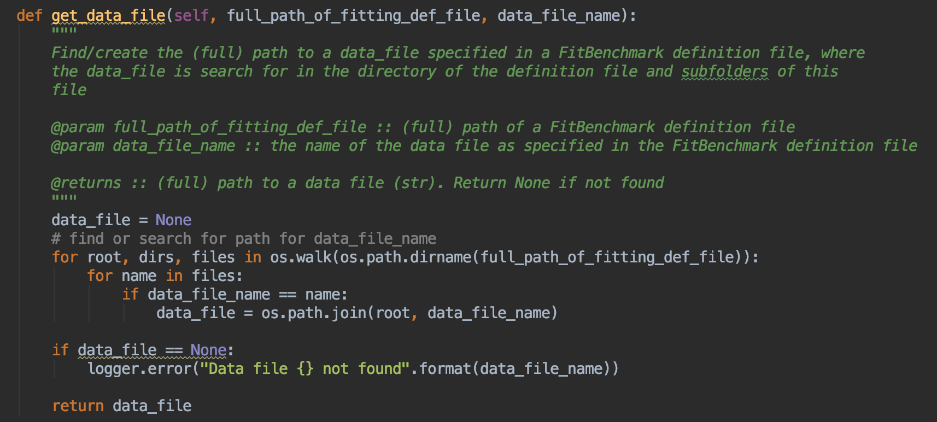
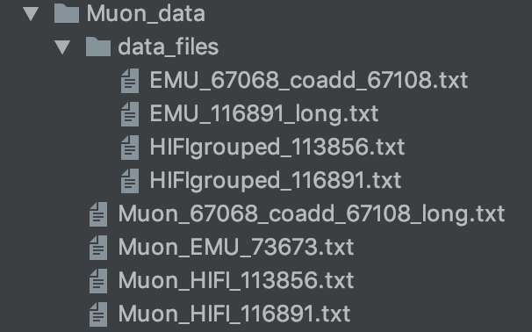
Example 2: Dynamic Path Finding Method
Improvement: os.walk is implemented to dynamically find the right file given the file name and its parent directory
The method was originally using a hard coded string “data_files” to find the correct directory
For FitBenchmark-type problems, the data files are located in the a subfolder called ‘data_files’
Notes:
Shorten title
Shorten explaination
Delete pic before

Slide 14
Summer Project Phase 2: Integration of SasView
Three main stages involved
Making FitBenchmarking independent of Mantid
Function Evaluation Method
Enable Bumps/SasView fitting on FitBenchmarking

Slide 15
Making FitBenchmarking independent of Mantid
Mantid packages are only imported in places where they are required
Example Script
Example Script
Example Script for Mantid
Notes:
Simplify second point

Slide 16
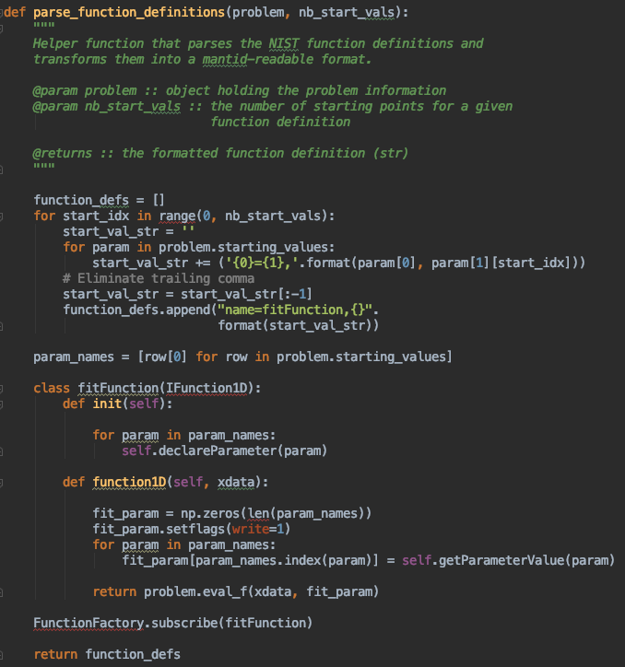
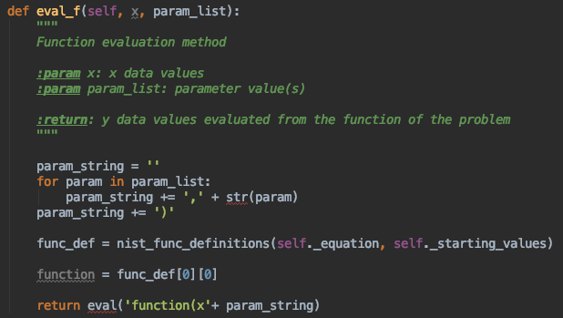
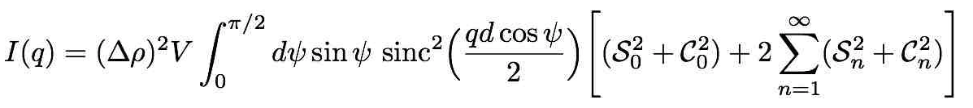
Function Evaluation Methods
Addition of the Function Evaluation Method
Example: Fitting using Mantid
Function to be used in Mantid fitting needs to be a form of a string
f(x)
Allow functions/models from one software to be used in another
OLD:
name=ExpDecayOsc,A=0.2,Lambda=0.2,Frequency=0.1,Phi=0
name=UserFunction,Formula=h*sin(a*x),h=2,a=1
name=UserFunction,Formula=h*sin(a*x),h=2,a=1
Difficult to write functions that are complex!
NEW:
name=fitFunction,h=2,a=1
Notes:
Format the text

Slide 17
SasView Integration
Parsing SasView data
Preparing the data
Preparing the function definition
Fitting using Bumps (Fitting package for SasView)

Slide 18
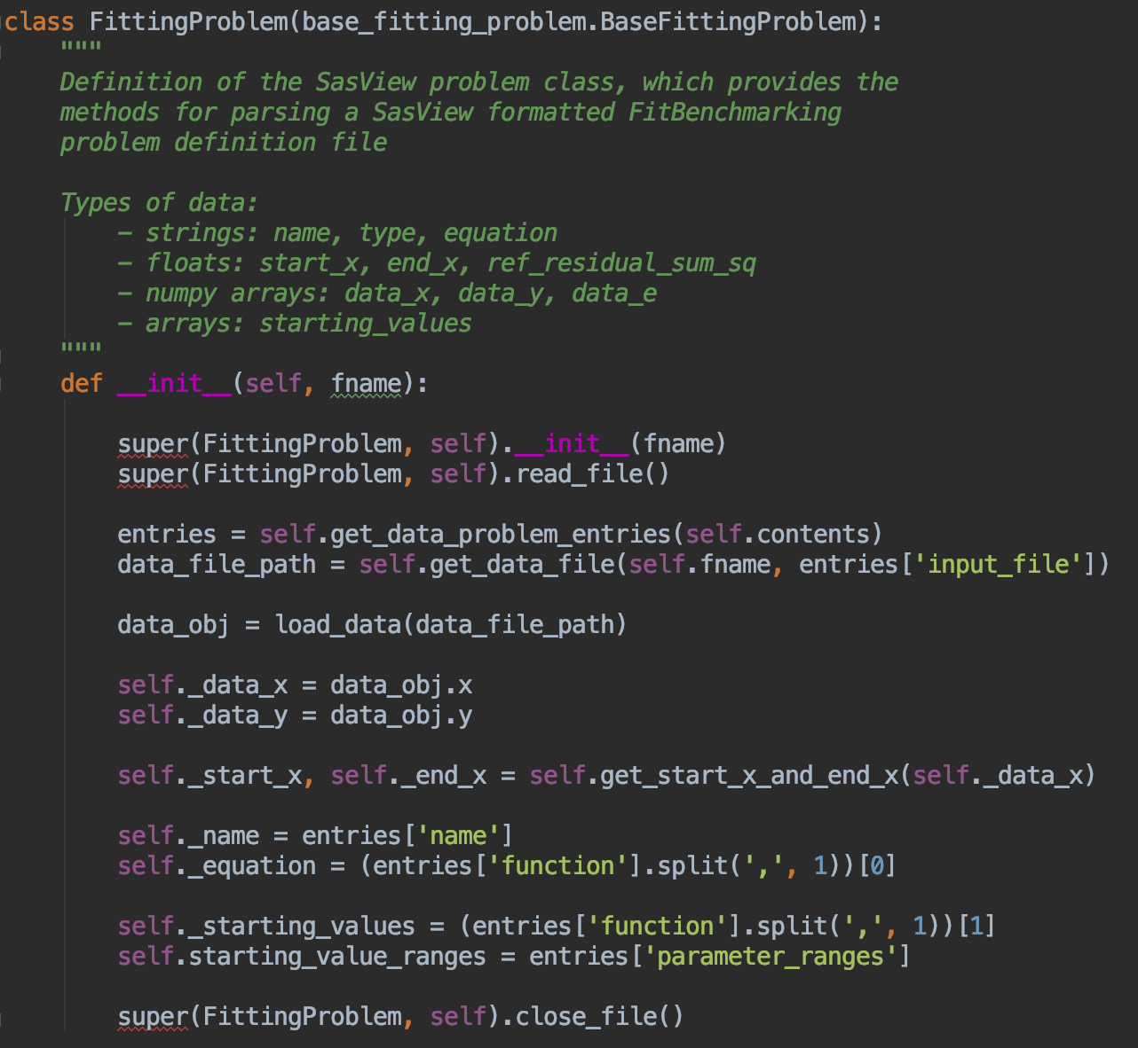
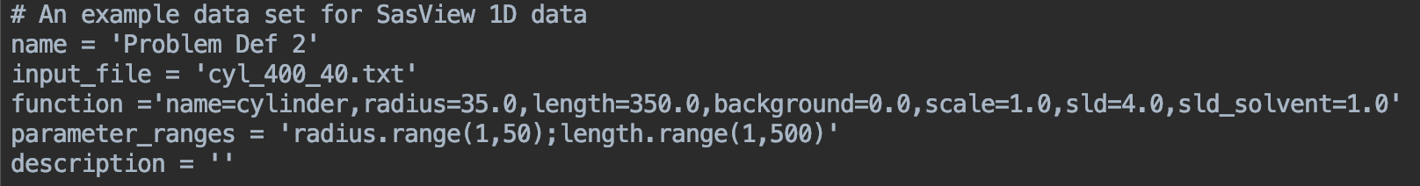
Preparing SasView Data
Notes:
Remove the first pic when the second comes up

Slide 19
Preparing the data
1
Construct the Acceptable Data Type for Bumps (sasmodels.data.Data1D)
2
Set Data Errors if Not Given
3
Set the X Value Range

Slide 20
Preparing the Function Definition
Prepares the function/model and its starting parameters
The function/model is prepared to be the type that is acceptable to SasView (Bumps)
[<function_obj>, [initial_params]]
Notes:
add NIST capital
Add figure

Slide 21
Fitting Using Bumps
Different from Other Software
Function Definition
Function Evaluation
Starting Parameter Values
Result
Function Wrapper
Problem Wrapper
Bumps Fitting Module
Optimal Parameter
Values
Formatting
Data Object
…
Data X
Minimizers List
Data Y
LevenbergMarquardtFit
Data E
SimplexFit
BFGSFit
Notes:
Emphasis on result
Add list of minimizers

Slide 22
Fitting Using Bumps
Result
Function Wrapper
Fitted Y Values
Graph Plotting Module
Table Creating Module
Optimal Parameter
Values
Function Evaluation

Slide 23
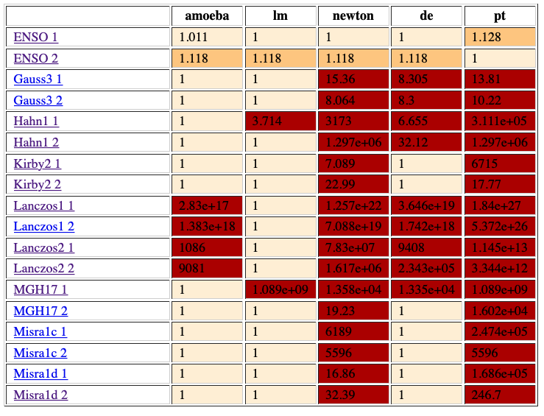
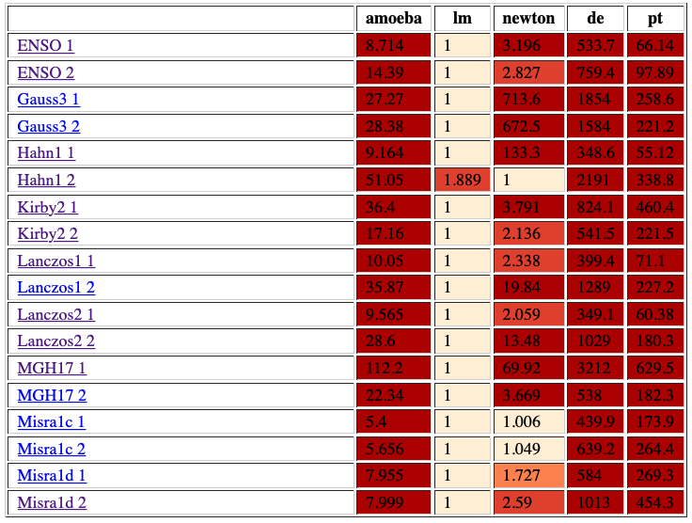
Tables obtained for NIST Problems
Accuracy Table
Runtime Table

Slide 24
Current Progress
Current Progress
The integration of SasView is successful.
Two SasView problems have been added
Capabilities:
Passing SasView function into Bumps fitting
Passing Mantid and Scipy functions into Bumps fitting
Passing SasView function into Mantid and Scipy fitting
Notes:
Add full stops
Bold successful
Shorten
Add more future work

Slide 25
Future Work
Future Work:
Add more SasView problems
Investigate the performance of Mantid, Scipy and SasView
Add setup.py build for SasView packages
Add a System Test
Next fitting software (RALFit?)
Notes:
Add full stops
Bold successful
Shorten
Add more future work
Installation Instruction

Slide 26
Thank you!
Special Thanks to:
Dr Anders Markvardsen
Mr Anthony Lim
Dr Michael Wathen
Dr Tyrone Rees
Dr Tim Snow
Dr Andrew McCluskey
Dr Stephen King
Mr Patrick Odagiu

